Slide 1


Slide 2

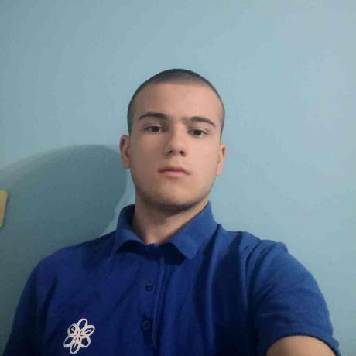
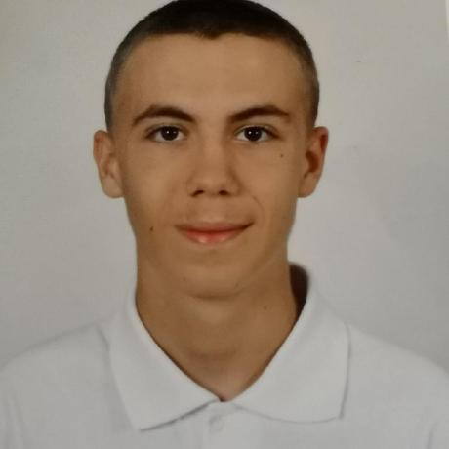
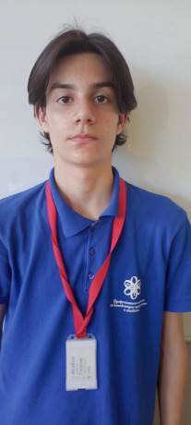
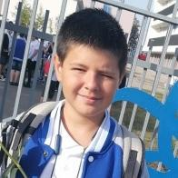
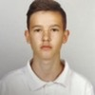
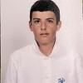
Team members
Nikolay Stoyanov
Miroslav Ivanov
Ivaylo Gyurov
Zlatin Lazarov
Ivelin Bozhilov
Scrum Trainer
Back-end Developer
Back-end Developer
Back-end Developer
QA Engineer
Kristian Dimitrov
Back-end Developer

Slide 3


Mission
Our mission is to make learning fun. So we are providing a game which gives a wonderful opportunity to those who want to learn still have an enjoyable experience.

Slide 4









Used technologies and languages

Slide 5
Now lets move to the game!

